Slide 1
Menus in android: lecture # 12

Slide 2



What is menu:
Menus provide a user interface for performing actions or navigation. Menus are a common user interface component in many types of applications. They typically offer a list of options or commands that can be accessed by the user.

Slide 3


Types of menus:

Slide 4

Option menu:
Options Menu: This is the primary collection of menu items for an activity. It is typically displayed when the user presses the menu button on the device (if the device has a menu button) or when the user interacts with the toolbar's overflow menu.

Slide 5

Context menu:
Context Menu: This menu appears when the user performs a long-click on a view. It provides actions that are specific to the view that was long-clicked.

Slide 6

Pop up menu:
Popup Menu: This is a simple menu that displays a list of items in a vertical list anchored to a view. It is typically used for actions that are context-specific to a particular item or view.

Slide 7
Option menu in xml and folder location:
The options menu can be defined in XML and loaded in the activity using onCreateOptionsMenu and onOptionsItemSelected.
XML Layout (res/menu/menu_main.xml)
XML Layout (res/menu/context_menu.xml)

Slide 8
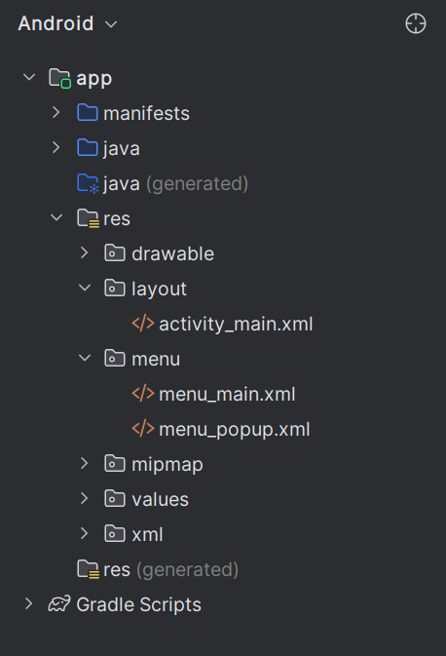
Folder structure:

Slide 9
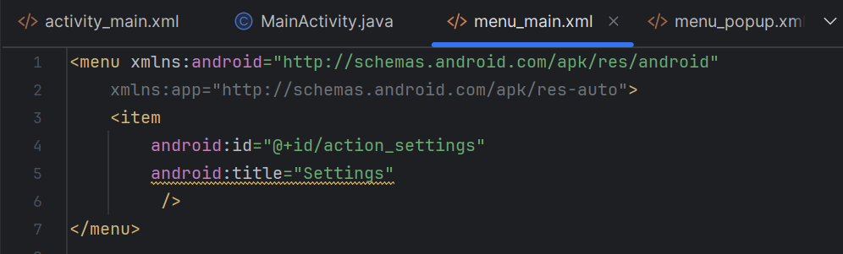
Menu_main.xml

Slide 10
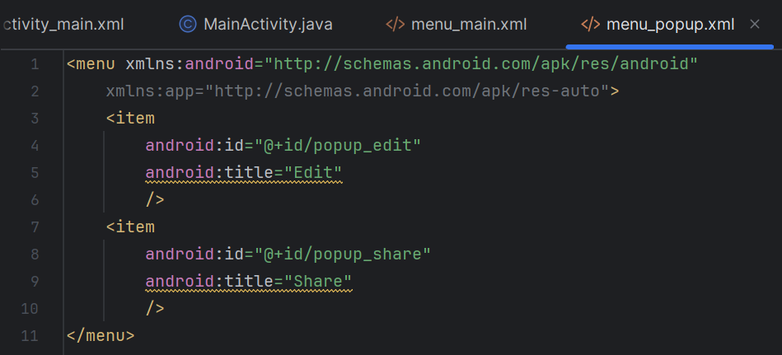
Menu_popup .xml

Slide 11
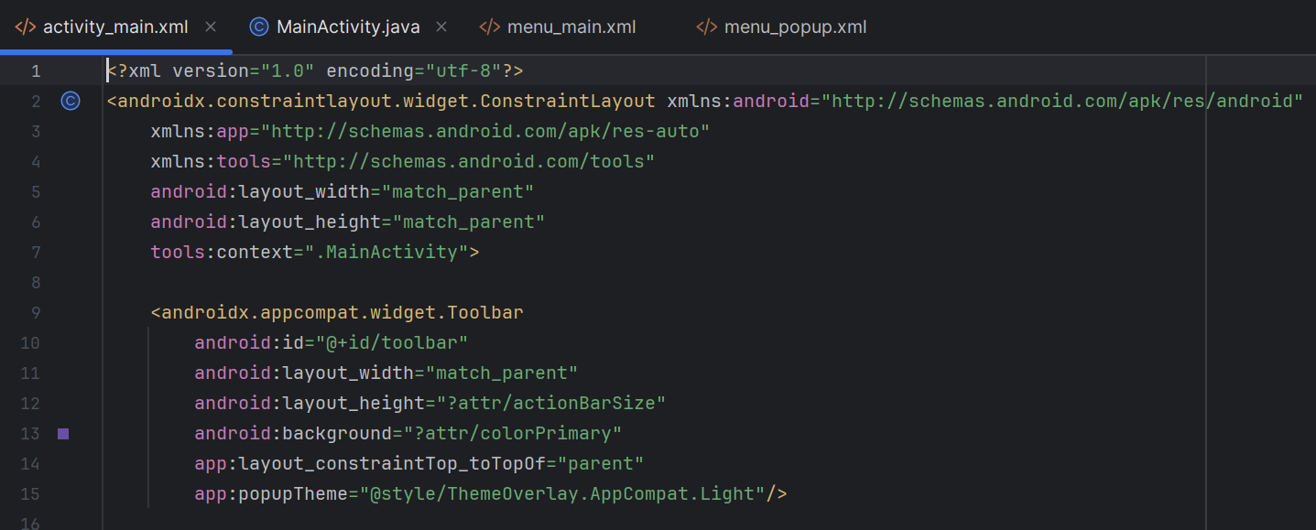
Activity_main.xml

Slide 12
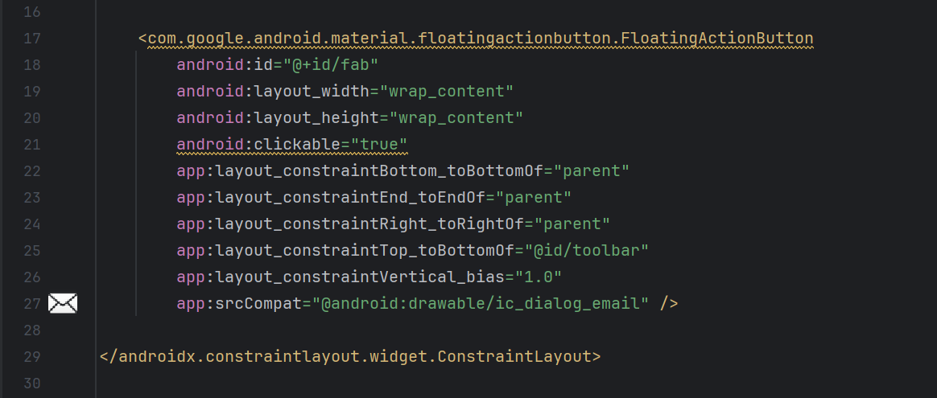
Continue:

Slide 13
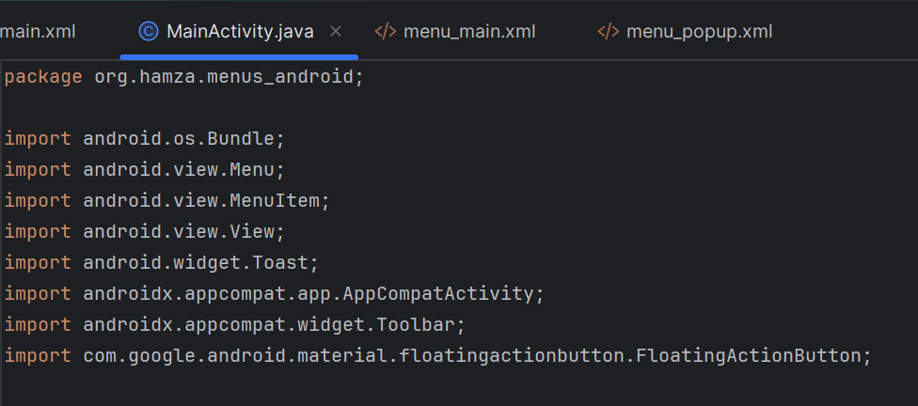
Main activity.java

Slide 14
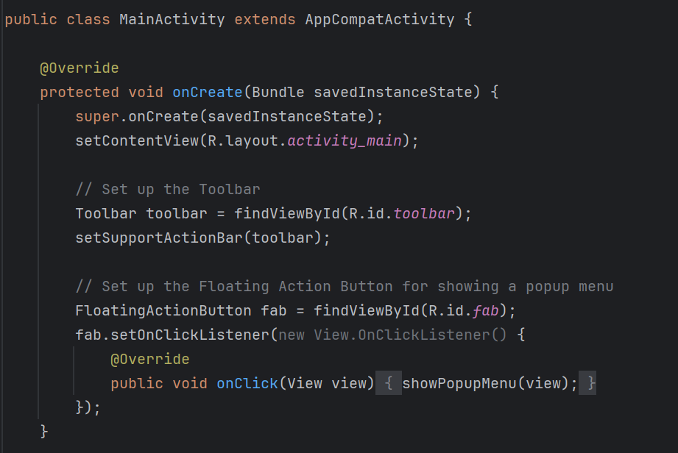
Continue:

Slide 15
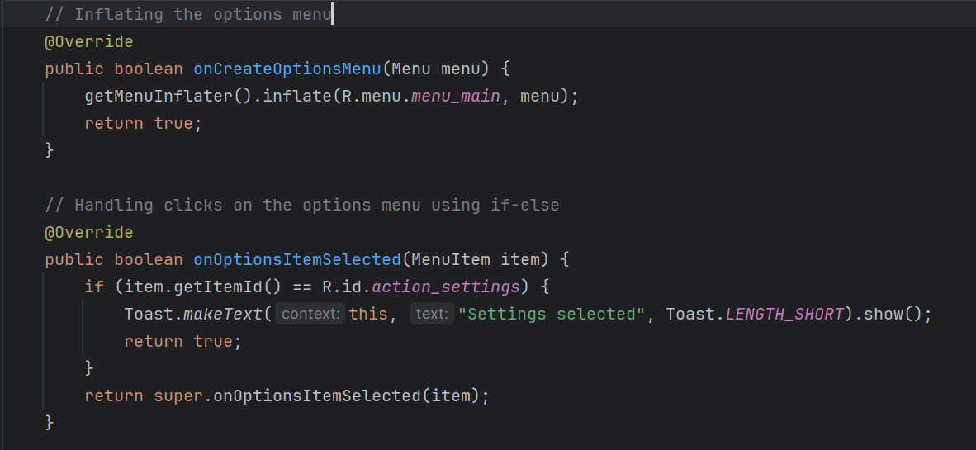
Continue:

Slide 16
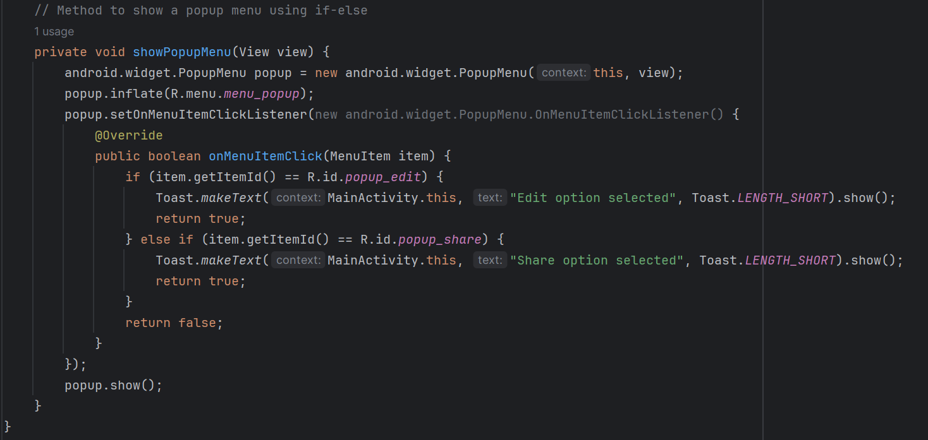
Continue:

Slide 17
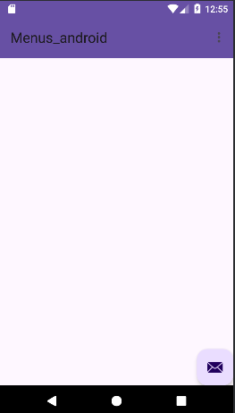

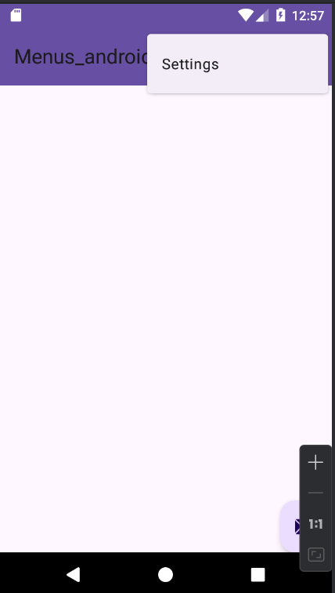
Output:

Slide 18
Task:
You are tasked with developing a basic e-commerce home page for an Android application. The home page should have an options menu that provides navigation and settings options. Additionally, each product item on the home page should have a popup menu with actions like "Add to Cart" and "Add to Wishlist.“
Home Page Layout: The home page should display a list of products.
Options Menu: The options menu should include "Home", "Profile", and "Settings".
Popup Menu: Each product item should have a button that shows a popup menu with "Add to Cart" and "Add to Wishlist" options.

